Slide 1
Word2Vec
Notes:
Hello and welcome to the second video of the first day of the course. This video is called Intuitions behind Neural Networws.

Slide 2
Outline
Motivation
Word2Vec from Scratch
The 20 Newsgroup Text Dataset

Slide 3
Motivation
Notes:
Hello and welcome to the second video of the first day of the course. This video is called Intuitions behind Neural Networws.

Slide 4
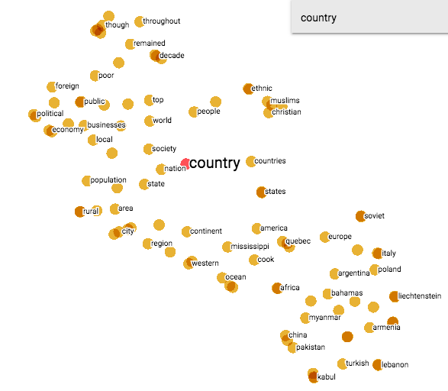
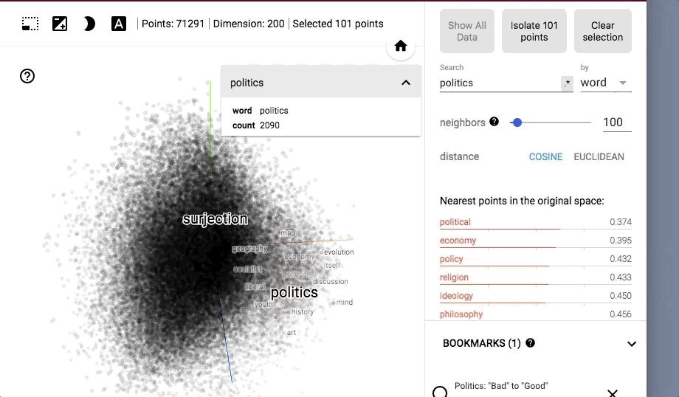
Word2Vec
Input: Wikipedia corpus
Dimension: 200
Output (CBoW): The model predicts the current word from a window of surrounding context words
Output (CSG): The model uses the current word to predict the surrounding window of context words
Examples from: http://projector.tensorflow.org/
Notes:
Word2vec can utilize either of two model architectures to produce a distributed representation of words: continuous bag-of-words (CBOW) or continuous skip-gram. In the continuous bag-of-words architecture, the model predicts the current word from a window of surrounding context words. The order of context words does not influence prediction (bag-of-words assumption). In the continuous skip-gram architecture, the model uses the current word to predict the surrounding window of context words. The skip-gram architecture weighs nearby context words more heavily than more distant context words.^{[1][5]} According to the authors' note,^{[6]} CBOW is faster while skip-gram is slower but does a better job for infrequent words.

Slide 5
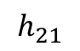
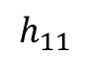
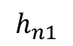



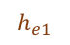
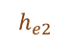
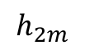
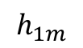
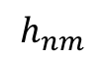
Embeddings
Recap from last Class
Area
$$h_{11}$$
$$⋯$$
$$h_{1m}$$
Nbhd | rooms | Area(m2) | Price
0 | 4 | 61 | 500k
1 | 5 | 72 | 600k
2 | 6 | 83 | 900k
3 | 7 | 91 | 1200k
… | … | … | …
# of rooms
$$h_{21}$$
$$⋯$$
$$h_{2m}$$
Price
North
$$⋮$$
EB
$$⋮$$
$$⋮$$
Fin. Distr.
Neighborhood
$$⋯$$
$$h_{n1}$$
$$h_{nm}$$
Tenderl
Soma
Cheaper
Civic
More Expensive
0
 | h_{e1} | h_{e2}
0 | w1 | w2
1 | w3 | w4
2 | w5 | w6
3 | w7 | w8
1
$$h_{e1}$$
South
2
3
$$h_{e2}$$
neibhd_to_idx={0:'Tender',1:'Civic',2:'FDist',3:'Soma'}
Notes:
A neural network is nothing more than a "giant function" that seeks to map a set of inputs - we will call X - and outputs - we will call y - from parameters - we will call w -. The fundamental block of the construction of a neural network are the 'perceptrons' - or units - represented by the following figure:

Slide 6
Embeddings
Recap from last Class
Area
$$h_{11}$$
$$⋯$$
$$h_{1m}$$
# of rooms
$$h_{21}$$
$$⋯$$
$$h_{2m}$$
Price
$$⋮$$
EB
$$⋮$$
$$⋮$$
Neighborhood
$$h_{n1}$$
$$⋯$$
$$h_{nm}$$
0
1
$$h_{e1}$$
2
3
$$h_{e2}$$
Notes:
A neural network is nothing more than a "giant function" that seeks to map a set of inputs - we will call X - and outputs - we will call y - from parameters - we will call w -. The fundamental block of the construction of a neural network are the 'perceptrons' - or units - represented by the following figure:

Slide 7
Embeddings
Recap from last Class
Area
$$h_{11}$$
$$⋯$$
$$h_{1m}$$
# of rooms
$$h_{21}$$
$$⋯$$
$$h_{2m}$$
Price
Word2Vec
$$⋮$$
$$⋮$$
$$⋮$$
Neighborhood
$$h_{n1}$$
$$⋯$$
$$h_{nm}$$
0
1
$$h_{e1}$$
2
3
$$h_{e2}$$
Notes:
A neural network is nothing more than a "giant function" that seeks to map a set of inputs - we will call X - and outputs - we will call y - from parameters - we will call w -. The fundamental block of the construction of a neural network are the 'perceptrons' - or units - represented by the following figure:

Slide 8
Embeddings
Recap from last Class
0
1
$$h_{e1}$$
2
3
$$h_{e2}$$
Notes:
A neural network is nothing more than a "giant function" that seeks to map a set of inputs - we will call X - and outputs - we will call y - from parameters - we will call w -. The fundamental block of the construction of a neural network are the 'perceptrons' - or units - represented by the following figure:

Slide 9
Embeddings
Recap from last Class
0
1
$$h_{e1}$$
2
$$h_{e2}$$
3
Notes:
A neural network is nothing more than a "giant function" that seeks to map a set of inputs - we will call X - and outputs - we will call y - from parameters - we will call w -. The fundamental block of the construction of a neural network are the 'perceptrons' - or units - represented by the following figure:

Slide 10
Embeddings
Recap from last Class
0
0
1
$$h_{e1}$$
1
2
2
$$h_{e2}$$
3
3
Notes:
A neural network is nothing more than a "giant function" that seeks to map a set of inputs - we will call X - and outputs - we will call y - from parameters - we will call w -. The fundamental block of the construction of a neural network are the 'perceptrons' - or units - represented by the following figure:

Slide 11
Embeddings
Recap from last Class
I am the king
0 1 2 3
0
0
1
$$h_{e1}$$
1
2
2
$$h_{e2}$$
3
3
Notes:
A neural network is nothing more than a "giant function" that seeks to map a set of inputs - we will call X - and outputs - we will call y - from parameters - we will call w -. The fundamental block of the construction of a neural network are the 'perceptrons' - or units - represented by the following figure:

Slide 12
Embeddings
Recap from last Class
I am the king
0 1 2 3
0
0
1
$$h_{e1}$$
1
2
2
$$h_{e2}$$
3
3
Notes:
A neural network is nothing more than a "giant function" that seeks to map a set of inputs - we will call X - and outputs - we will call y - from parameters - we will call w -. The fundamental block of the construction of a neural network are the 'perceptrons' - or units - represented by the following figure:

Slide 13
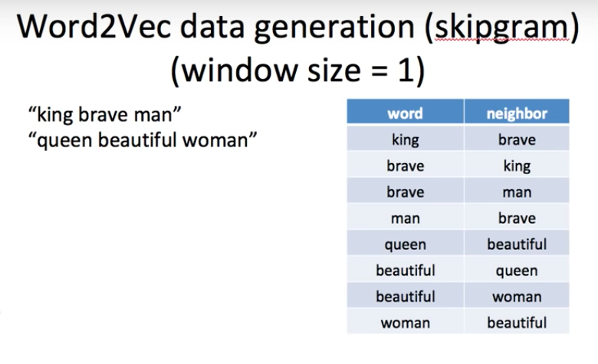
Embeddings
How to build the dataset?
https://www.youtube.com/watch?v=64qSgA66P-8
Notes:
A neural network is nothing more than a "giant function" that seeks to map a set of inputs - we will call X - and outputs - we will call y - from parameters - we will call w -. The fundamental block of the construction of a neural network are the 'perceptrons' - or units - represented by the following figure:

Slide 14
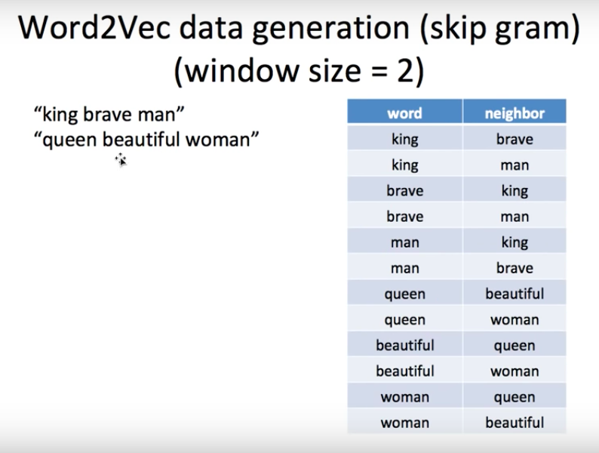
Embeddings
How to build the dataset?
https://www.youtube.com/watch?v=64qSgA66P-8
Notes:
A neural network is nothing more than a "giant function" that seeks to map a set of inputs - we will call X - and outputs - we will call y - from parameters - we will call w -. The fundamental block of the construction of a neural network are the 'perceptrons' - or units - represented by the following figure:

Slide 15
Word2Vec from Scratch
Notes:
Hello and welcome to the second video of the first day of the course. This video is called Intuitions behind Neural Networws.

